Slide 1

Global Internet Usage by Moitry Sarkar

Slide 2
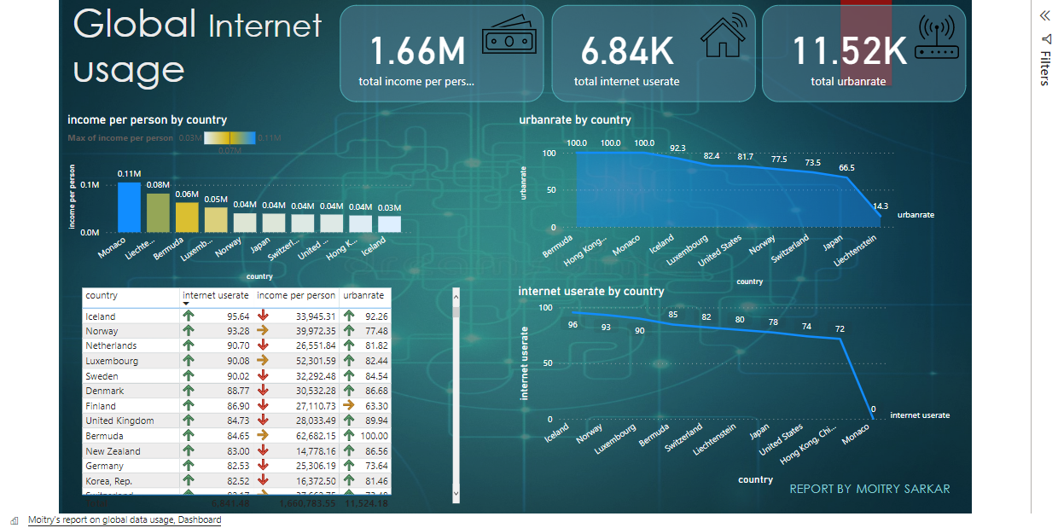
This dashboard represents the usage of the internet by the countries globally based on each country’s income per person, internet use rate, and urban rate. In this report, I have used DAX & aggregate functions for sum of totals, Rankx, and TopN filter functions.

Slide 3

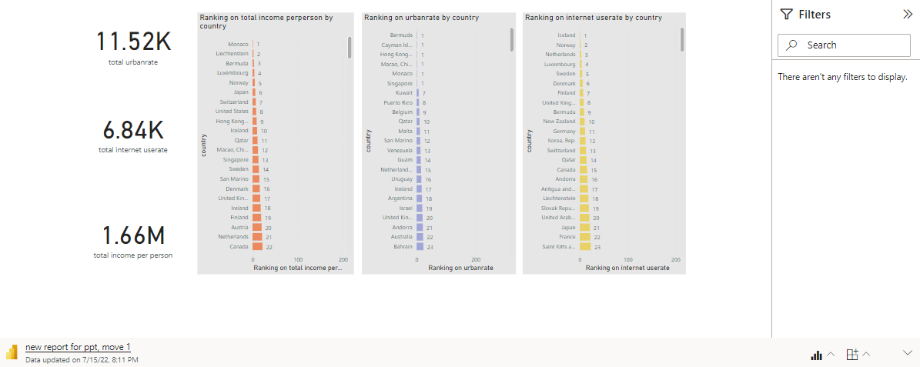
Using the rankx function in power bI , all the countries have been ranked based on their maximum income per person, urban rate,& user rate. This is an interactive dashboard.

Slide 4
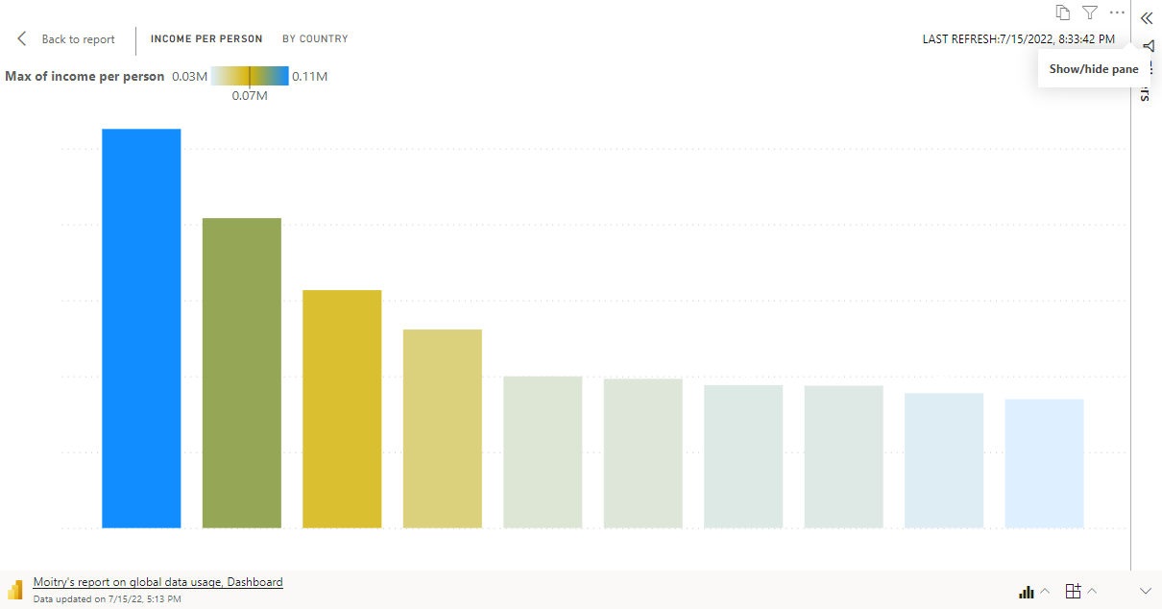
Using the Top N function, Top 10 countries have been filtered based on the income per person measure. Monaco stands to be the highest in making income.

Slide 5
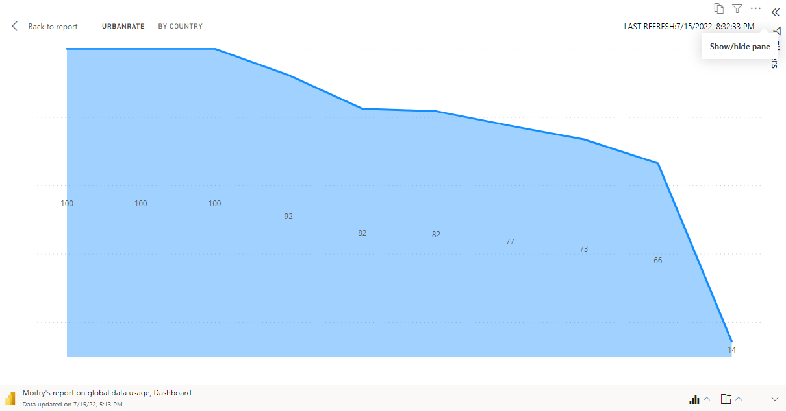
This dashboard represents the usage of the internet by the countries globally based on each country’s income per person, internet use rate, and urban rate. In this report, I have used DAX & aggregate functions for sum of totals, Rankx, and TopN filter functions.

Slide 6
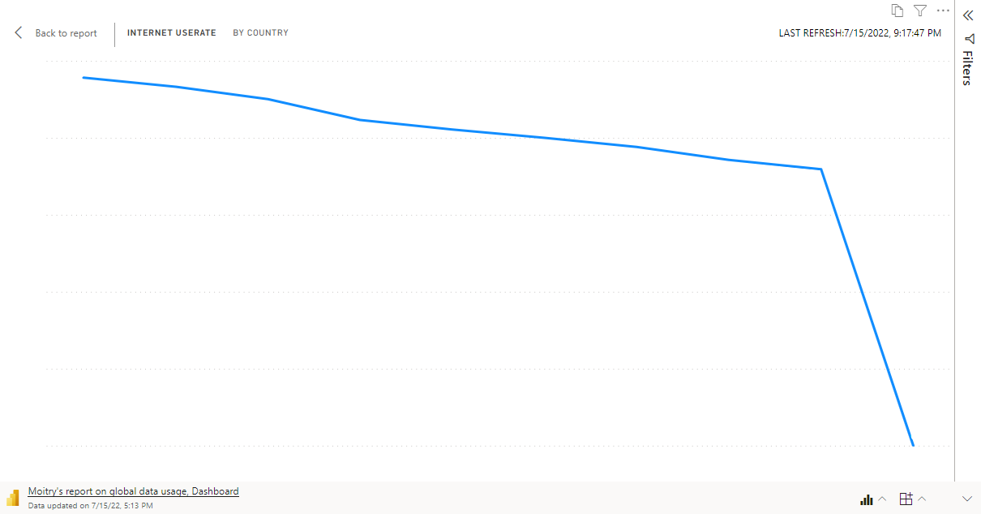
Iceland is in the number 1 position as analyzed with the rankx function based on internet user rate. This is a chart and its non-interactive.

Slide 7
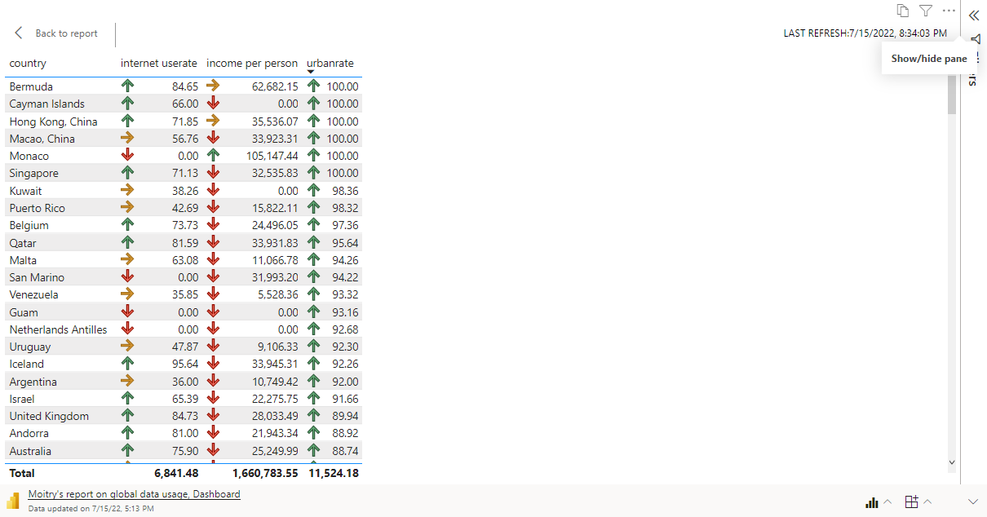
The symbolic arrows in red, Yellow and Green categorizes the Countries as above 30%,60% and 90% respectively based on their income, user rate and urban rate.

Slide 8
Thank you !

